Slide 1

Email speech assistant
Under guidance of
Dr. Figlu Mohanty

Slide 2

Team Members
2110030014-G.Haritha Maithreyee
2110030032-D.Neha
2110030056-B.Akshita
2110030067-A.Bhavya Sri
21100300457-V.Charishma

Slide 3
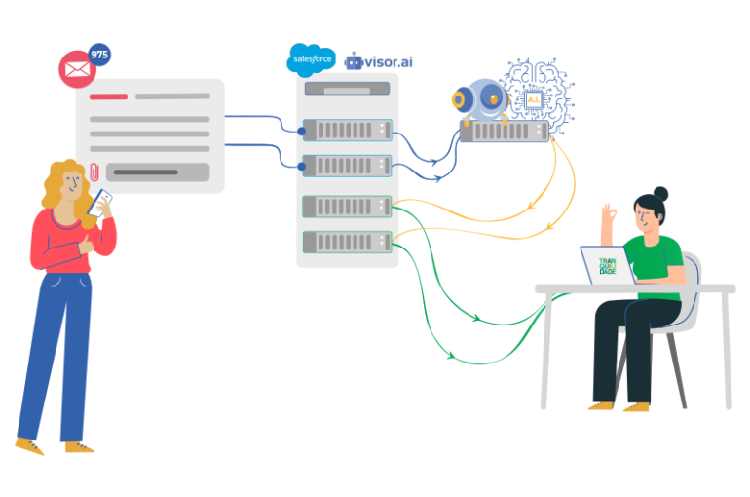
Email speech assistant
Email is the most effective and formal way to communicate with others.
Replying to emails is a lengthy and hardly automated task. Repetitive email conversations are not only time-consuming but also frustrating and non-challenging for qualified and motivated employees.
So, by thinking in a smart manner, we can reduce the task of typing to just speech.
Now, the point is how this works. This is an email speech assistant in which users need to just speak whatever they want to send as an email. That is this application converts speech to text while sending an email.

Slide 4
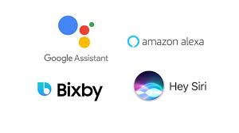
Literature Survey
Intelligent Virtual Assistant (IVA) is “an application that utilization information, for example, the user’s voice…and logical data to give help by noting inquiries in normal dialect, making suggestions and performing activities”.
There have already been many voice assistants to simplify users’ day-to-day tasks.
Few examples of speech assistants include Google Assistant, Siri (in iPhones), Alexa by Amazon, and many more.
But this is a voice assistant that dedicatedly works for Emails.

Slide 5
Dataset collection (taken from github)
AESDD - around 500 utterances by a diverse group of actors (over 5 actors) simlating various emotions.
ANAD - 1384 recording by multiple speakers; 3 emotions: angry, happy, surprised.
Arabic Speech Corpus - The Arabic Speech Corpus (1.5 GB) is a Modern Standard Arabic (MSA) speech corpus for speech synthesis. The corpus contains phonetic and orthographic transcriptions of more than 3.7 hours of MSA speech aligned with recorded speech on the phoneme level. The annotations include word stress marks on the individual phonemes.
ASR datasets - A list of publically available audio data that anyone can download for ASR or other speech activities
AudioMNIST - The dataset consists of 30000 audio samples of spoken digits (0-9) of 60 different speakers
Awesome_Diarization - A curated list of awesome Speaker Diarization papers, libraries, datasets, and other resources.
BAVED - 1935 recording by 61 speakers (45 male and 16 female).

Slide 6
CaFE - 6 different sentences by 12 speakers (6 females + 6 males).
Common Voice - Common Voice is Mozilla's initiative to help teach machines how real people speak. 12GB in size; spoken text based on text from a number of public domain sources like user-submitted blog posts, old books, movies, and other public speech corpora.
CHIME - This is a noisy speech recognition challenge dataset (~4GB in size). The dataset contains real simulated and clean voice recordings. Real being actual recordings of 4 speakers in nearly 9000 recordings over 4 noisy locations, simulated is generated by combining multiple environments over speech utterances and clean being non-noisy recordings.
And many more

Slide 7
Software and hardware requirements
Software Requirements:
Programming Language: Python 3.9
Tools: Anaconda or Pycharm
Operating System: Windows
Hardware Requirements:
RAM: 2GB or above
Processor: i3 or above
Processor speed: 2.4GHz
Hard disk: 500GB

Slide 8
Future work
71% of consumers already prefer voice search to manual typing since it’s much faster and also allows them to multitask. But as voice assistants become more powerful, easier to use, and able to understand context far better, more people will turn to voice search and virtual assistants for help with their everyday tasks.
The future of voice search and assistants is looking bright. With the number of people already seeing how convenient those tools can be and the growing number of devices that use voice recognition.
This application is a useful one that reduces the task of typing an email as while typing we may come across spelling errors or typos. This may reduce the effectiveness of our email to the person to whom we send mail.
In the future it can be seen as famous work as a google assistant or Siri if developed properly.

Slide 9
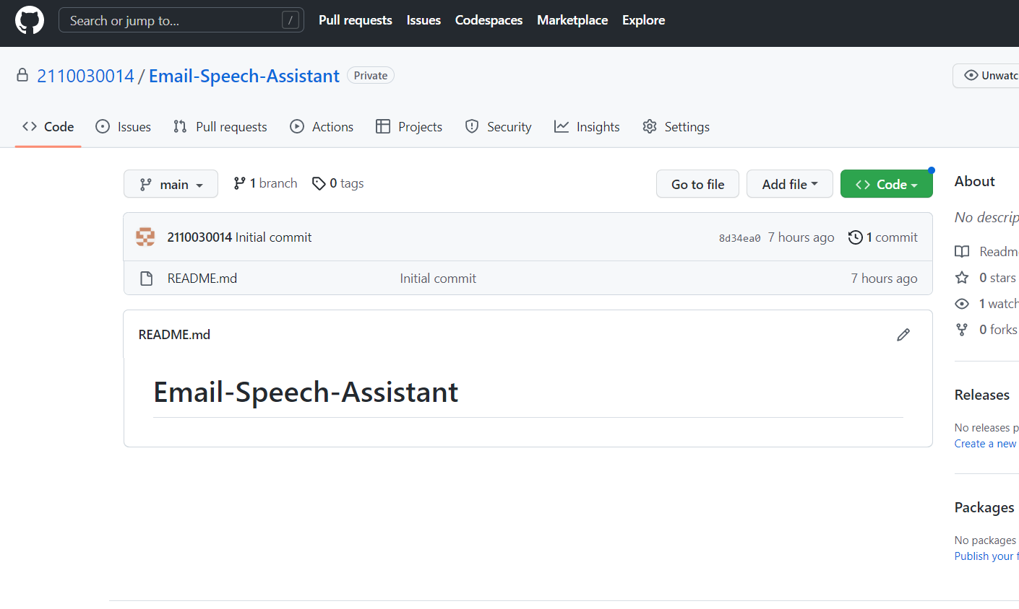
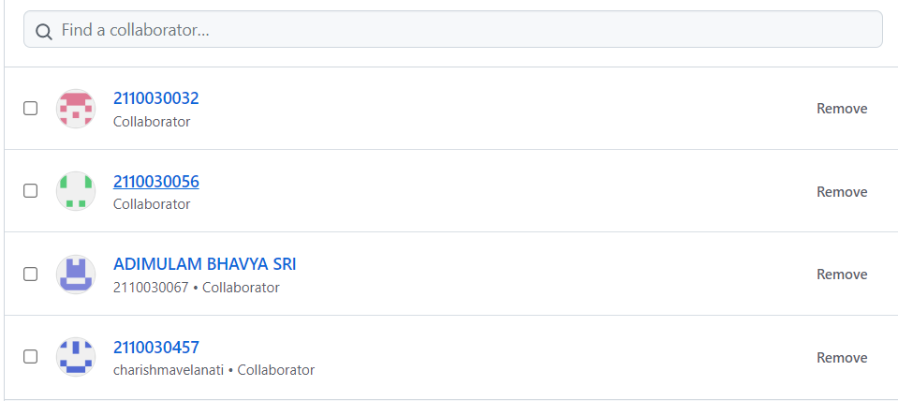
GitHub setup
https://github.com/2110030014/Email-Speech-Assistant/

Slide 10
references
https://avleonov.com/2019/02/18/how-to-make-email-bot-service-in-python
https://www.citethisforme.com/topic-ideas/technology/chatbot-23911731
https://medium.com/mailbots/introducing-mailbots-bots-for-email-41602dd145d0
https://www.visor.ai/email-bots-how-to-automate-your-mailbox/

Slide 11
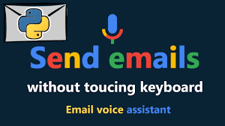
Thank You

